Slide 1


:
Social Media Security
Presenting by:-
Satvik
Vindya
va

Slide 2
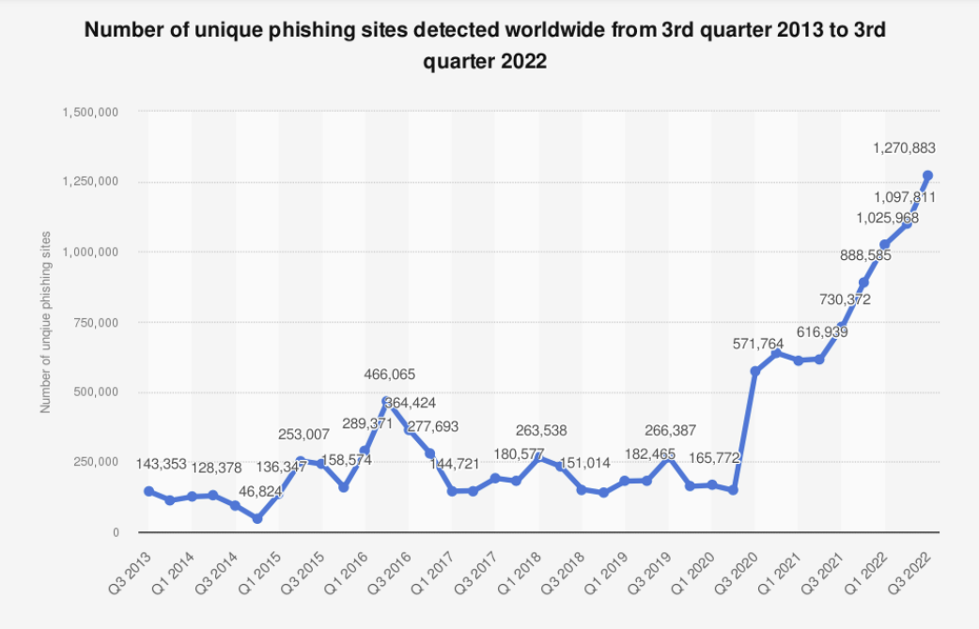
PHISHING
va

Slide 3
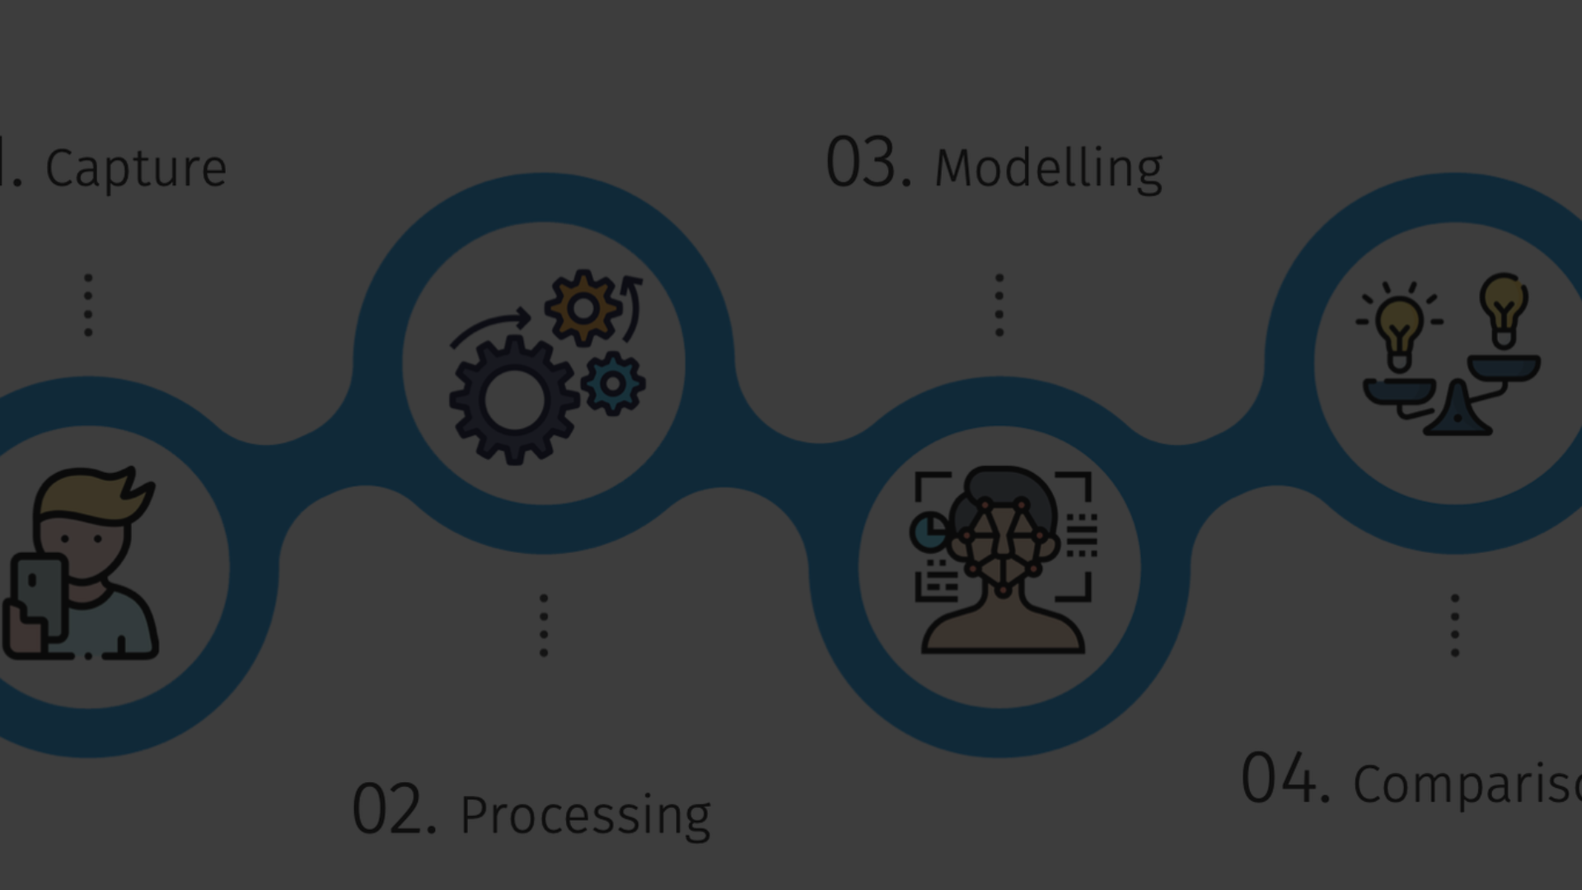
PROBLEMS DUE TO PHISHING
1
Financial Losses
2
Deep Fakes
3
Loss of personal information

Slide 4
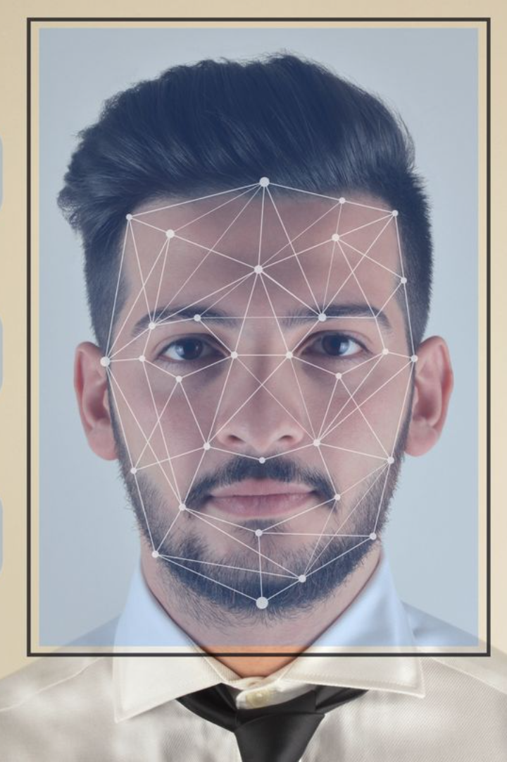
Face Biometrics
Face biometrics is a cutting-edge technology used for identity verification and access control. It involves analyzing and measuring facial features to uniquely identify individuals.
va

Slide 5
How Face Biometrics Work
1
Data Capture
Facial recognition systems capture and analyze facial characteristics such as distance between the eyes and face shape.
2
Feature Extraction
Key facial features are extracted and converted into digital data for comparison and identification.
3
Matching & Verification
The extracted facial data is matched against stored templates to verify an individual's identity.

Slide 6
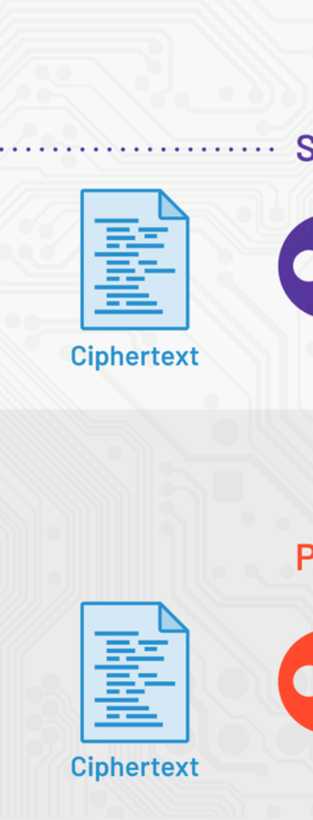



ALGORITHMS USED-
OpenBR
MTCNN(Multi Task Cascaded
Convulated Network)
SHA-256

Slide 7
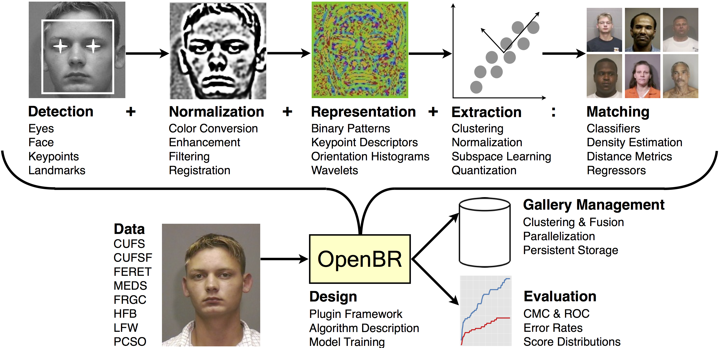

Slide 8
Impact of Social Media on Privacy
1
Data Exposure
2
Online Tracking
3
Reputation Risks
Social media platforms can lead to unintentional exposure of personal information and activities.
They may track user activities, leading to targeted advertising and potential privacy breaches.
Posting personal content online can pose risks to one's reputation and professional image.

Slide 9

Protecting Privacy on Social Media Platforms
Privacy Settings
Content Moderation
Users can customize privacy settings to control the visibility of their personal information and posts.
Engaging in content moderation ensures that shared information aligns with personal privacy boundaries.
Education and Awareness
Educating users about privacy risks and safe online practices is essential for protecting personal data.

